Slide 1

COSI 104a Introduction to machine learning
Chapter 17 – PCA & t-SNE
 | Instructor: Dr. Hongfu Liu Email: hongfuliu@brandeis.edu
The class notes are a compilation and edition from many sources. The instructor does not claim intellectual property or ownership of the lecture notes.

Slide 2
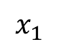
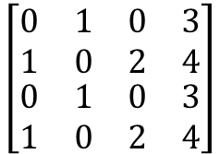
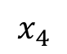
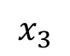
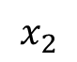
Motivation – a Simple Example
$$x_{1}$$
$$x_{2}$$
$$x_{3}$$
$$x_{4}$$
sample 1
sample 2
$$\left[\begin{matrix}\begin{matrix}\begin{matrix}0 \\ 1\end{matrix} & \begin{matrix}1 \\ 0\end{matrix}\end{matrix} & \begin{matrix}\begin{matrix}0 \\ 2\end{matrix} & \begin{matrix}3 \\ 4\end{matrix}\end{matrix} \\ \begin{matrix}\begin{matrix}0 \\ 1\end{matrix} & \begin{matrix}1 \\ 0\end{matrix}\end{matrix} & \begin{matrix}\begin{matrix}0 \\ 2\end{matrix} & \begin{matrix}3 \\ 4\end{matrix}\end{matrix}\end{matrix}\right]$$
sample 3
sample 4

Slide 3
Covariance
Positive covariance.
Negative covariance.
x₂
x₂
x₁
x₁

Slide 4
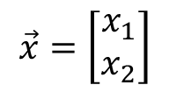
Example of Principal Components (PC)
The smallest PC corresponds to the direction that minimizes the variance of the projected data.
The largest PC corresponds to the direction that maximizes the variance of the projected data.
x₂
$$\vec{x}=\left[\begin{matrix}x_{1} \\ x_{2}\end{matrix}\right]$$
x₁

Slide 5
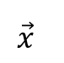
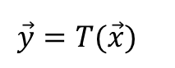
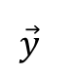
Overview
Principal Component Analysis (PCA) is a standard technique widely used for linear dimensionality reduction in statistical pattern recognition and signal processing.
$$\vec{y}=T(\vec{x})$$
$$\vec{x}$$
$$\vec{y}$$
Unsupervised Learning for discovering significant patterns or features in the data.
PCA is also known as the Karhunen-Loève (KL) transformation in communication theory.
Notes:
The transformation is designed in such a way that the data set may be represented by a reduced number of “effective” features and yet retain most of the intrinsic information content of the data.

Slide 6
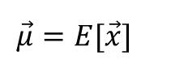
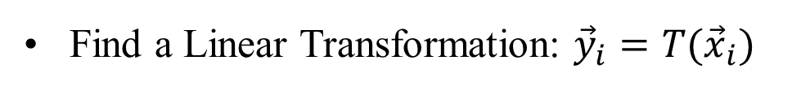
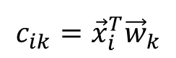
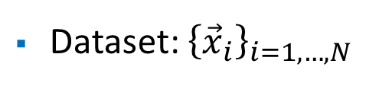
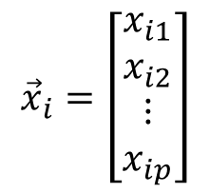
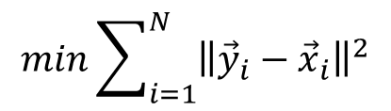
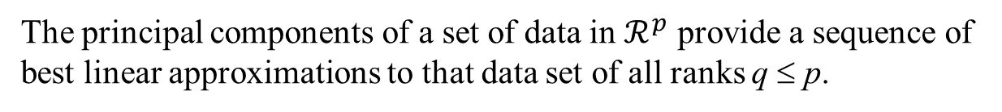
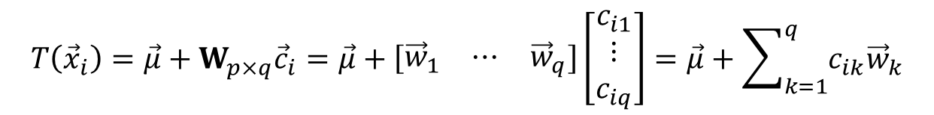
Compute PCs
$${\vec{x}}_{i}=\left[\begin{matrix}\begin{matrix}x_{i1} \\ x_{i2}\end{matrix} \\ \begin{matrix}⋮ \\ x_{ip}\end{matrix}\end{matrix}\right]$$
Dataset: ${\left\{{\vec{x}}_{i}\right\}}_{i=1,…,N}$
$$\vec{μ}=E[\vec{x}]$$
Find a Linear Transformation: ${\vec{y}}_{i}=T({\vec{x}}_{i})$
$$min\sum_{i=1}^{N}{{\left\|{\vec{y}}_{i}−{\vec{x}}_{i}\right\|}^{2}}$$
$$T\left({\vec{x}}_{i}\right)=\vec{μ}+W_{p×q}{\vec{c}}_{i}=\vec{μ}+\left[\begin{matrix}{\vec{w}}_{1} & ⋯ & {\vec{w}}_{q}\end{matrix}\right]\left[\begin{matrix}c_{i1} \\ ⋮ \\ c_{iq}\end{matrix}\right]=\vec{μ}+\sum_{k=1}^{q}{c_{ik}{\vec{w}}_{k}}$$
q ≤ p
${\left\{{\vec{w}}_{k}\right\}}_{k=1,…q}$ are the principal components, and $\left\|{\vec{w}}_{k}\right\|=1$
${\left\{c_{ik}\right\}}_{k=1,…q}$are the principal component scores of ${\vec{x}}_{i}$
$$c_{ik}={{\vec{x}}_{i}^{T}\vec{w}}_{k}$$
The principal components of a set of data in $ℛ^{p}$ provide a sequence of best linear approximations to that data set of all ranks q ≤ p.

Slide 7
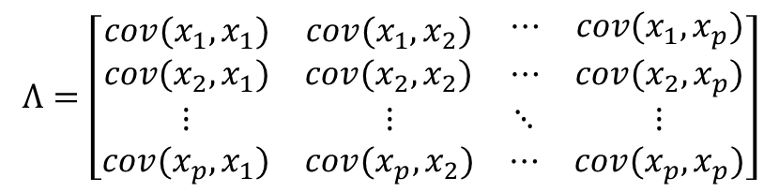
PCA reduces dimensionality by projecting each data point onto the first few principal components:
Obtain lower-dimensional data
Preserve as much variation in the original data as possible.
The principal components are eigenvectors of the covariance matrix.
$$Λ=\left[\begin{matrix}\begin{matrix}cov(x_{1},x_{1}) & cov(x_{1},x_{2}) \\ cov(x_{2},x_{1}) & cov(x_{2},x_{2})\end{matrix} & \begin{matrix}⋯ & cov(x_{1},x_{p}) \\ ⋯ & cov(x_{2},x_{p})\end{matrix} \\ \begin{matrix}⋮ & ⋮ \\ cov(x_{p},x_{1}) & cov(x_{p},x_{2})\end{matrix} & \begin{matrix}⋱ & ⋮ \\ ⋯ & cov(x_{p},x_{p})\end{matrix}\end{matrix}\right]$$
PCA can be computed by Singular Value Decomposition (SVD)

Slide 8
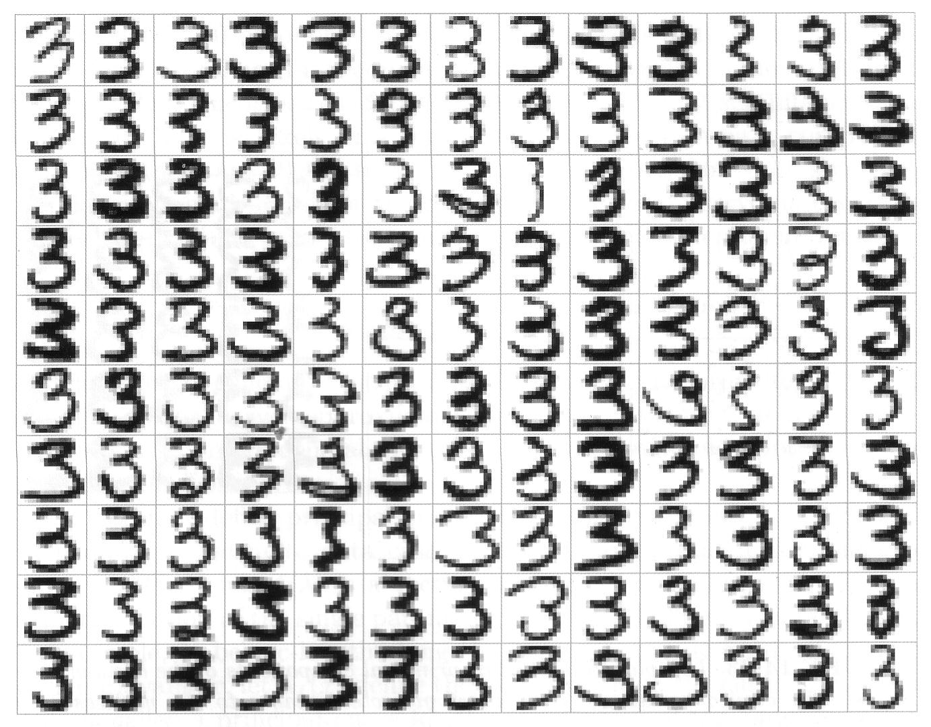
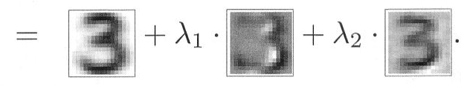
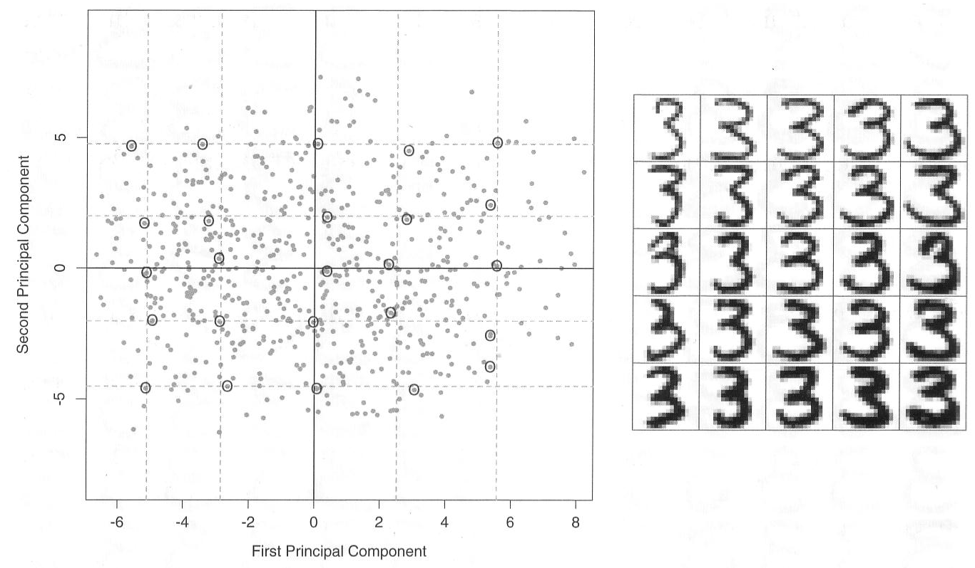
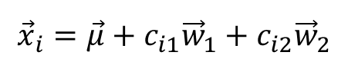
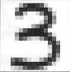
Example – Handwritten Digits
Reconstruction using the first two PCs
130 samples
Two-component model
c_{i1}
c_{i2}
$${\vec{x}}_{i}=\vec{μ}+c_{i1}{\vec{w}}_{1}+c_{i2}{\vec{w}}_{2}$$
From Hastie, Tibshirani, Friedman 2001

Slide 9
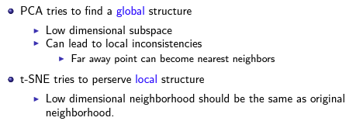
Local embedding

Slide 10
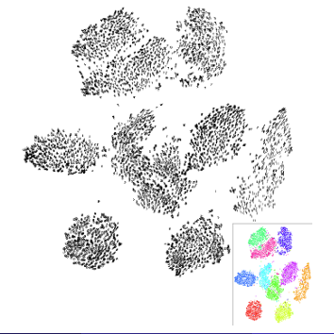
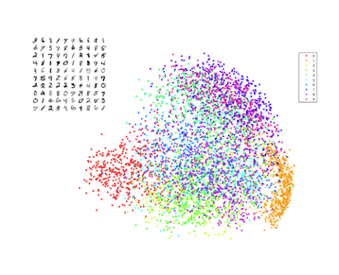

Slide 11
https://scikit-learn.org/0.16/modules/generated/sklearn.manifold.TSNE.html
Video

Slide 12


